Slide 1


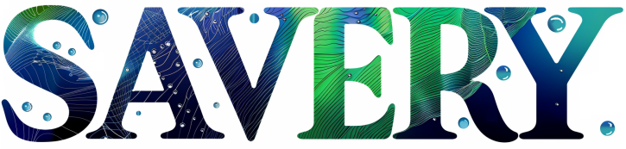
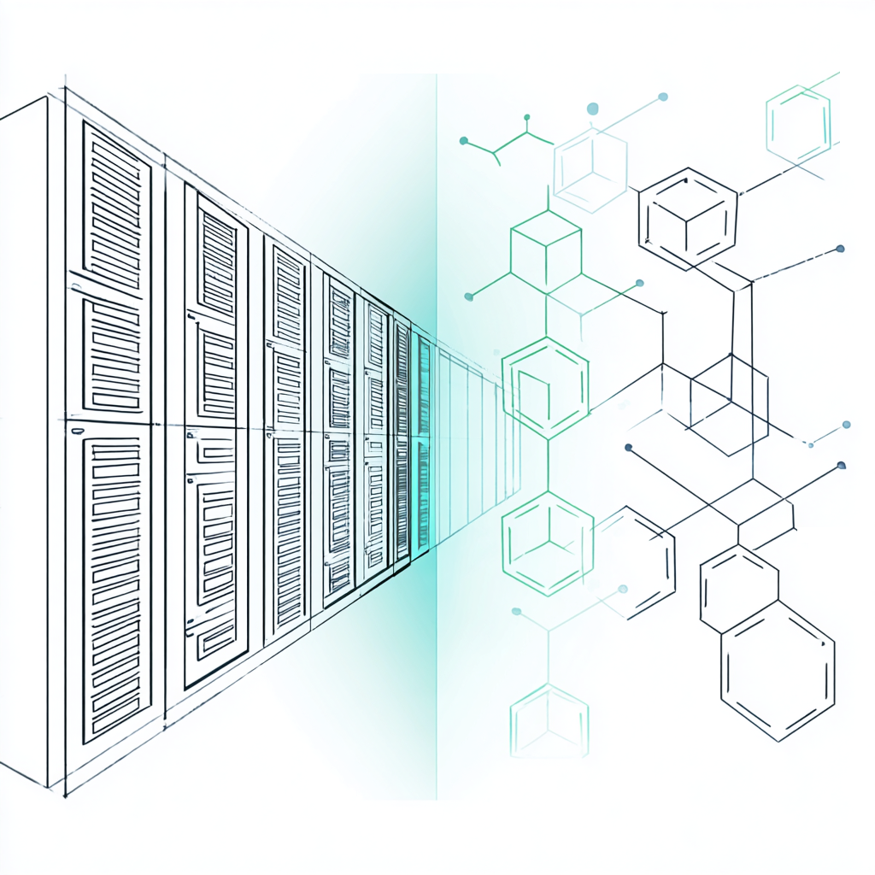
AirTransformerTM
Transforming Heat into Coolness: The Sustainable Future of Data Centers
09.2025 Paris
Transform the residual heat sink
into a dynamic thermal hub
CONFIDENTIEL © 2024-2028 Savery Tech

Slide 2


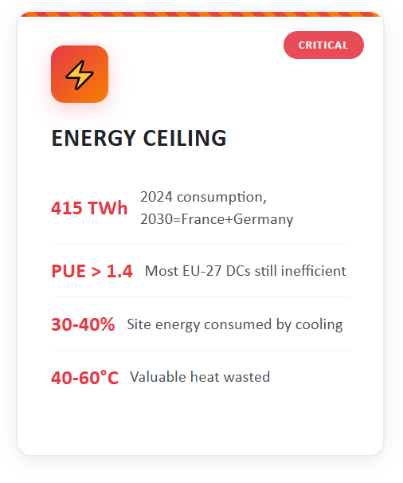
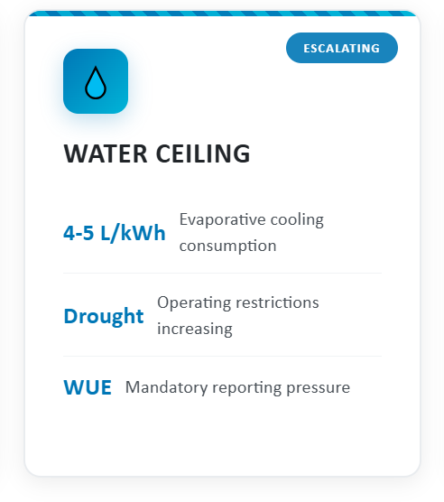
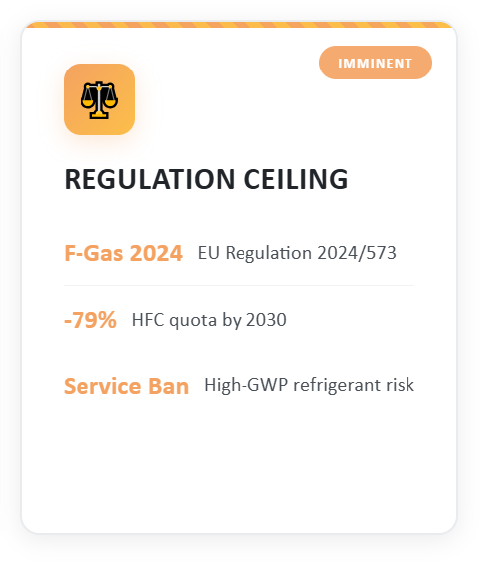
The digital‑age energy crunch
Three Ceilings Constraining EU Data Centers
Critical barriers demanding breakthrough innovation
A large amount of heat produced is currently lost at low temperatures, without recovery.
AirTransformer: Less water, less energy, more impact
CONFIDENTIEL © 2024-2028 Savery Tech
Notes:
We’ve hit three ceilings—energy, water, regulation—so airflow tweaks won’t do; we must change the physics of cooling. Many EU‑27 sites still run PUE above 1.4; a third of site energy goes to cooling while nearly all IT power leaves as 40–60 °C heat we mostly dump into the environment. Evaporative towers save compressor work but consume 4–5 L per kWh of cooling; drought restrictions and WUE reporting are now operational constraints. The EU F‑Gas 2024/573 phase‑down tightens sharply—raising costs and refill risk for legacy refrigerants. Hence HESTIA: change the physics—tandem MOF sorption to route and valorise that 40–60 °C band.

Slide 3
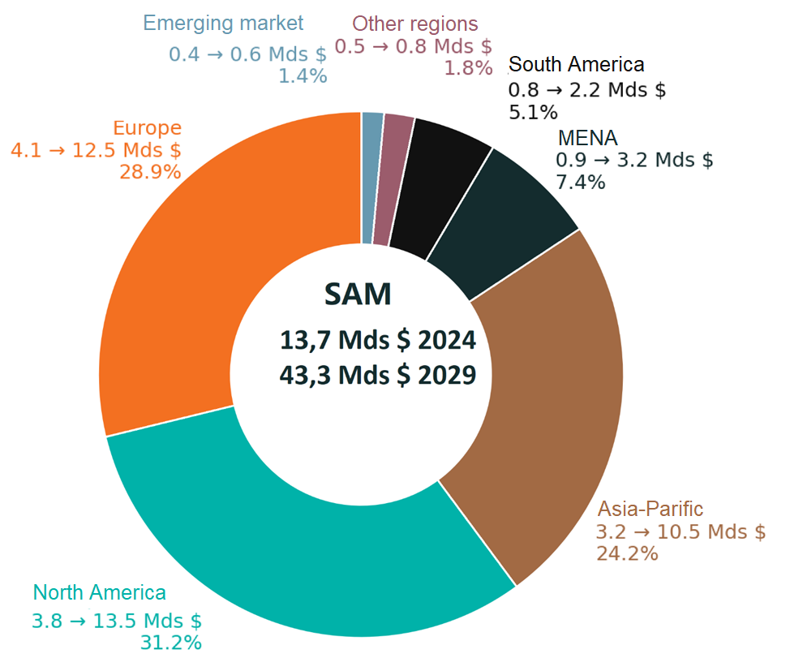



Accessible Market
Exponential growth in computing needs:
  Generative AI, Big Data, Cloud
  Critical need for high-density cooling.
Rapid expansion of the digital sector:
  Strong growth of hyperscalers and shared infrastructures (colocation).
  Massive deployment of edge computing networks.
Europe leading in sustainability:
  Eco-efficient data centers (PUE < 1.2): less energy wasted, more heat recovered.
  Strict standards: EN50600, ESG criteria, demanding public policies.
AirTransformer: Less water, less energy, more impact
CONFIDENTIEL © 2024-2028 Savery Tech
Notes:
Europe is seeking to lower PUE < 1.2, which simply means that for every 1 kWh used directly by servers, less than 0.2 kWh of additional energy is needed for their cooling and associated technical infrastructure.

Slide 4
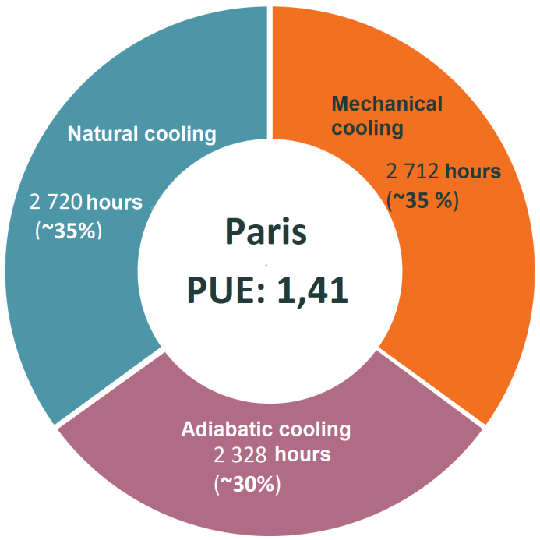
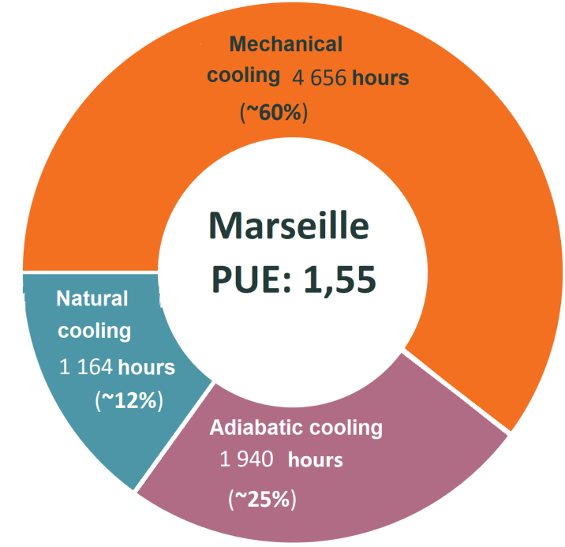


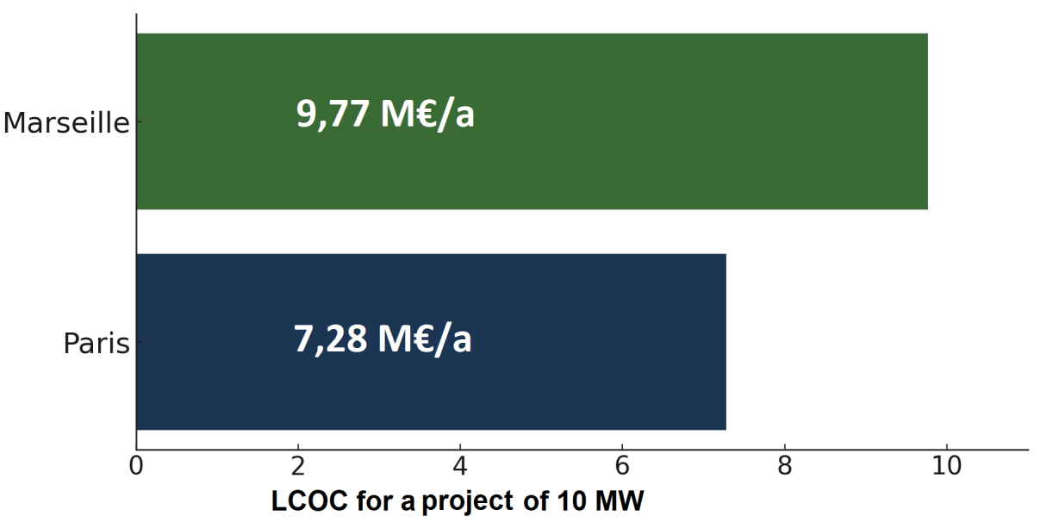


Major challenges, significant obstacles
Dependence on climate variations
Fragmented design and ad-hoc solutions
Heavy initial investments
Complex and costly renovation of existing facilities
AirTransformer: Less water, less energy, more impact
CONFIDENTIEL © 2024-2028 Savery Tech
Notes:
In warmer regions like Marseille, the limited number of free cooling hours requires massive use of energy-intensive chillers for a large part of the year, leading to significantly higher operating costs (OpEx) and CO₂ emissions. Most data centers assemble various systems (partial free cooling, adiabatic cooling, etc.), but still remain very dependent on mechanical cooling due to the lack of mature “turnkey” technology to fully cover needs. Advanced cooling solutions (direct chip cooling, immersion, heat recovery, etc.) often require considerable infrastructure changes (fluid networks, specific equipment) and have extended returns on investment (ROI), which hinders their adoption. Existing facilities cannot easily adopt advanced solutions without major overhaul. Even new projects can face constraints related to the terrain (lack of district heating network) or limited budgets, hampering innovation. Opportunities for heat reuse (district heating, industrial processes) remain rare or unprofitable. Potential gains in terms of sustainable development therefore remain unexploited, and operators continue to reject heat into the atmosphere. Advanced cooling technologies (liquid circuits, immersion) require new skills (fluid management, specific maintenance), which can slow their adoption in an already stressed operational environment. Rising electricity costs in Europe accentuate these difficulties: mechanical cooling, which may have seemed viable at a lower cost, quickly becomes prohibitive with fluctuating prices, weighing on both OpEx and the carbon footprint.

Slide 5
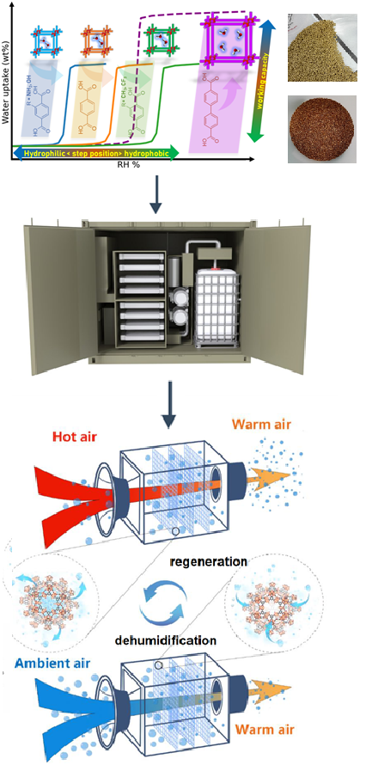
AirTransformerTM solution
Technology & Positioning
Advanced cooling system validated (TRL 5–6).
“Zero-to-one” innovation: no commercial equivalent exists.
Reversible cycle without compressor or fluorinated refrigerant.
Uses residual heat to desorb water vapor from a porous material, thereby generating cooling.
Performance & Advantages
Savings: PUE from ≈1.50 to ≤1.30 → ~€3M per year for a 10 MW site.
Consumption: –60 to –80% for cooling electricity, –50% for makeup water.
Easy installation: “plug-and-play” module in parallel with existing systems.
Strategic Value
Aligned with energy transition, decarbonization, and digital sovereignty.
Fills an industrial gap for adsorbent materials and green cooling.
Stimulates the local economy: materials, equipment, and energy management.
Materials
Equipment
Control
AirTransformer: Less water, less energy, more impact
CONFIDENTIEL © 2024-2028 Savery Tech

Slide 6
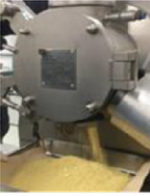
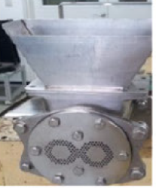
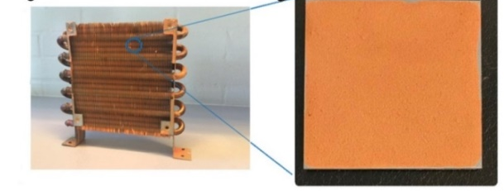
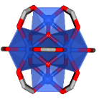
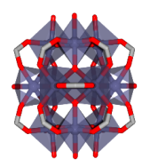
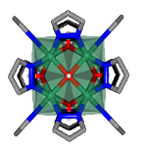
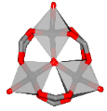
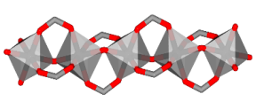
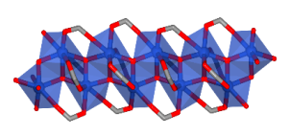
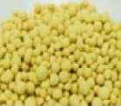
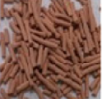

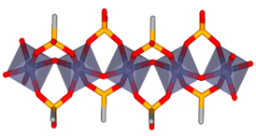
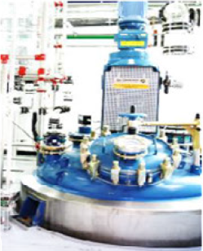

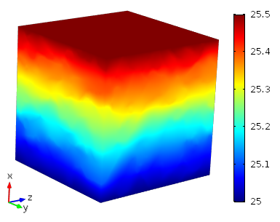
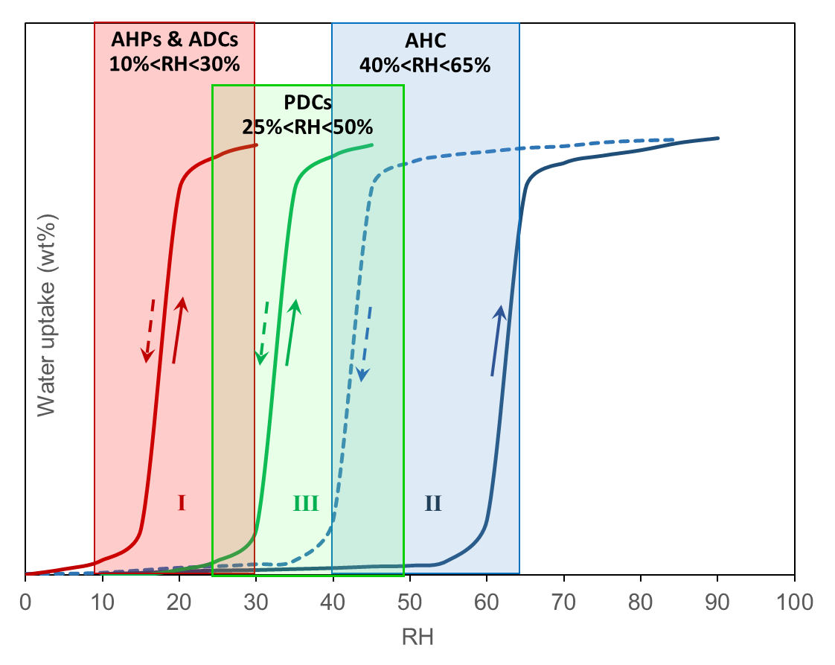
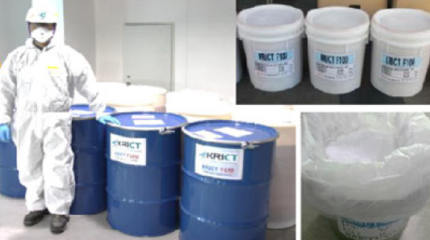
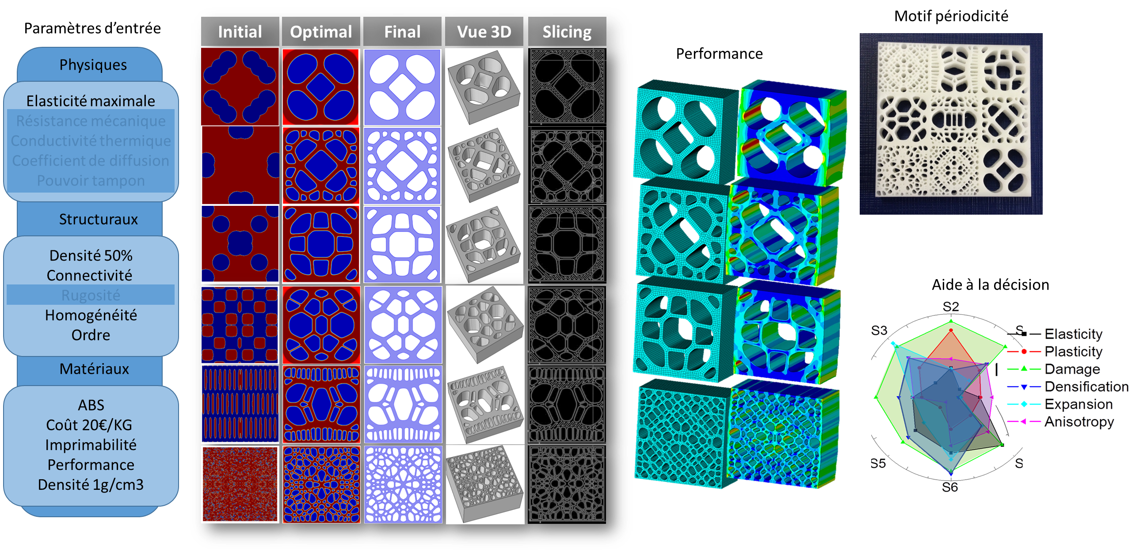
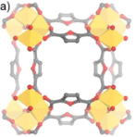
Breakthrough Technology Module: Materials
Design and regulation of the microstructure: complete life cycle:
Origin of the Technology
Research stemming from collaborations between ENS Paris and CNRS.
Over €15M in R&D and 20 years of expertise in porous materials and thermodynamics (FP7, H2020, HE).
Previous-generation materials reached MRL-9 (scaling to k-ton production) in partnership with major chemical companies (e.g.BASF).
Metal-oxo clusters
Metal-oxo chains
More than 200 materials developed since 2010 using molecular computing and robotic synthesis.
The new materials are in the pilot phase at MTR-7.
Adjustable hydrophilic/hydrophobic molecular balance.
Precise control of heat/mass natures via AI modeling.
Rigorous tests: accelerated aging, corrosion, fatigue, A/B, etc.
Seo et al., Adv Mater, 2012; Cadiau et Al, Adv Mater 2015; Lenzen et al, Nat Commun 2019; Cho et al, Nature Commun 2020; Mouchaham et al, Trend in Chemistry 2020; Gkaniatsou et al. Cell Rep Phys Sci 2022; Cho et al, Adv. Science 2023, Shen et al, Chem Rev. 2024, Gong et al. JACS 2024
CONFIDENTIEL © 2024-2028 Savery Tech

Slide 7
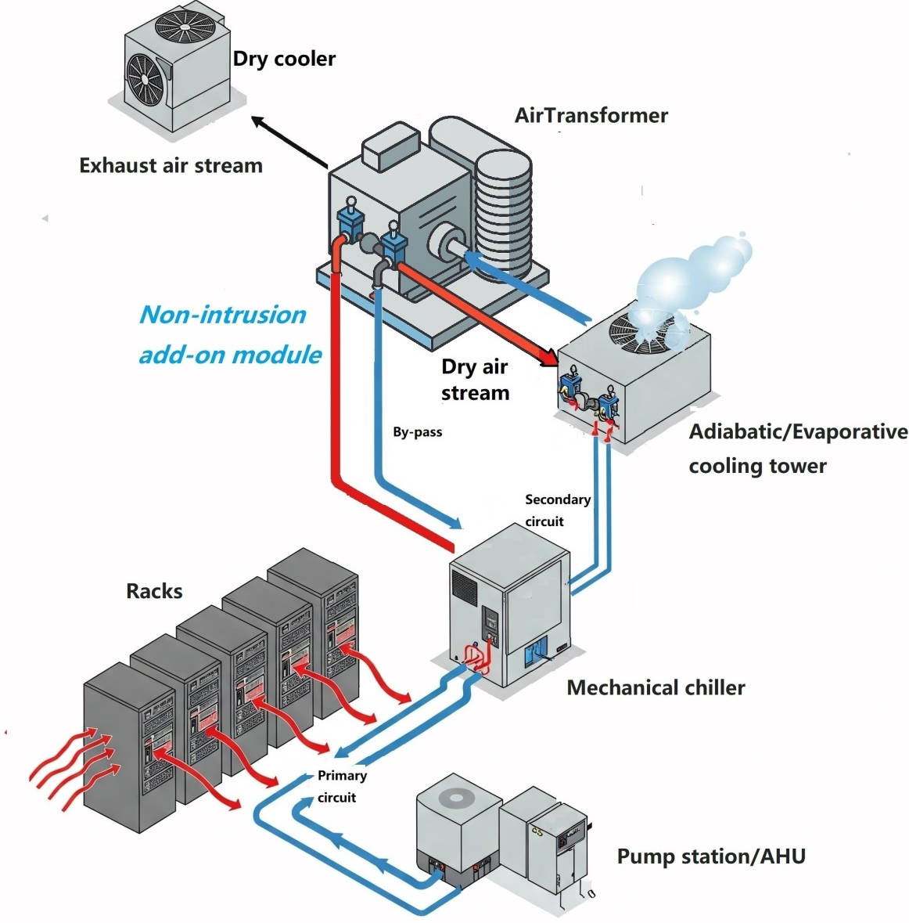





Breakthrough Technology Module: Equipment
AirTransformer™ : Recovery of waste heat to optimize cooling
Enhanced cooling
Adiabatic tower outlet temperature lowered by 10 to
15°C.
Water as a natural refrigerant
Sustainable solution with no direct environmental impact
Flexibility and robustness
Adapts to all phases of fatal heat
Plug-and-play extension
Quick add/remove to adjust capacity
Ultra low power consumption
Limited to powering pumps and ventilation
Virtually no impact on the electrical grid
AirTransformer: Less water, less energy, more impact
CONFIDENTIEL © 2024-2028 Savery Tech

Slide 8
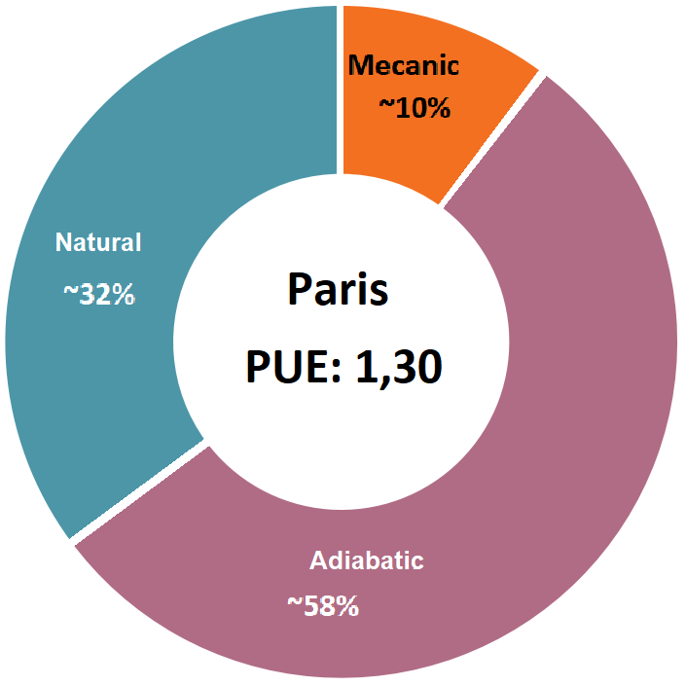
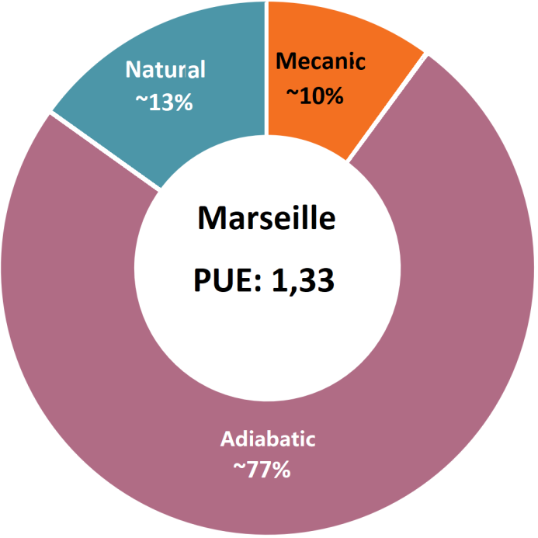


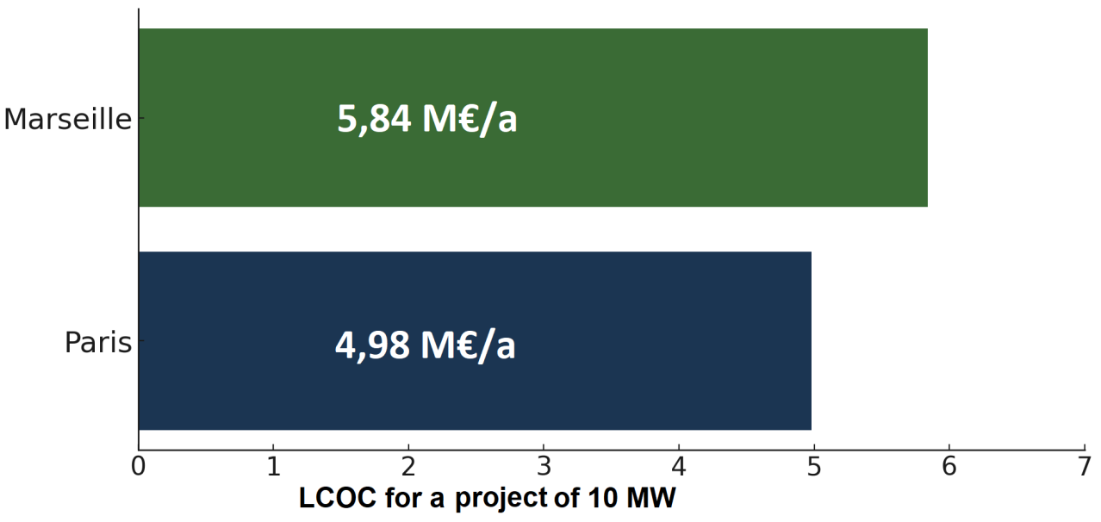

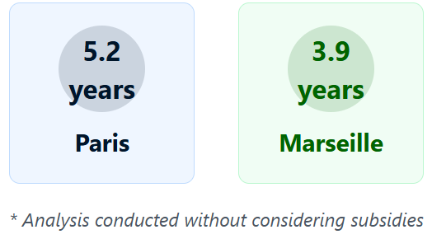
Revolutionary solution: economical& sustainable sustainable
Climate Independent
Works perfectly even in hot or humid weather.
Reduction of water consumption
Up to -40% compared to conventional systems
PUE improvement
Up to 80% electricity savings dedicated to cooling
Waste heat transformed into a resource
Transitioning from a costly thermal liability to a valuable
energy asset
Return on Investment Time
AirTransformer: Less water, less energy, more impact
CONFIDENTIEL © 2024-2028 Savery Tech

Slide 9

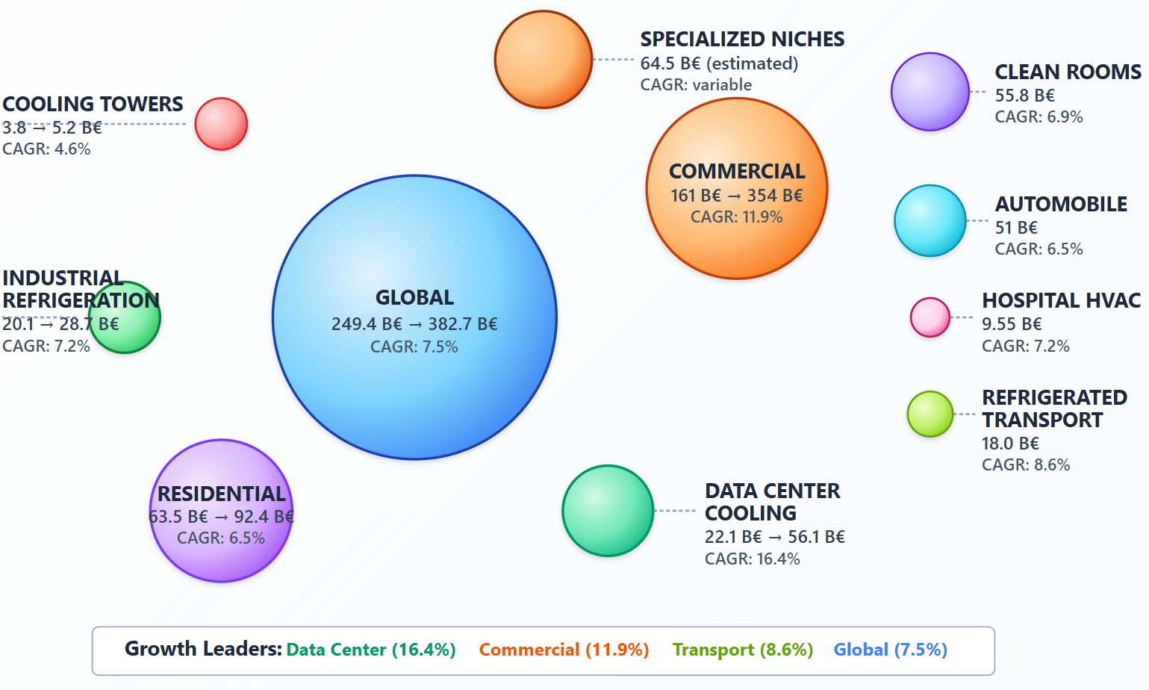

Market vision
Why now?
AirTransformer: Less water, less energy, more impact
Notes:
Now because the drivers have aligned: AI loads push heat densities up, water and refrigerant constraints harden, and low‑grade heat is widely available but underused. Materials have matured to give steep, tunable isotherms in the 40–80 °C band; ML for physics is finally fast and trustworthy enough for 1 Hz control.

Slide 10
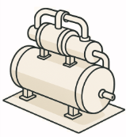















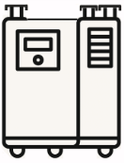





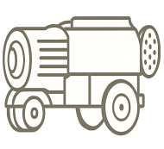






Technology landscape
Technology | Average EER | Actors | Advantages | Limits
CRAC/CRAH (compression) | 8 – 13 |  | * Proven technology *Significant capabilities for large sites | * Significant impact on the electrical grid, especially during peak periods * CFC/HFC refrigerant
Adiabatic / Evaporative | 10-17 (depends on humidity) |  | * Low electrical consumption * Reduced initial investment | * Sensitive to ambient humidity * Limited temperature drop
Liquid / Immersion | 15-30 ( >50°C the source) |  | * High efficiency * Good thermal density | * High CapEx * High system complexity
Classical sorption | 6-30 (depends on the source temperature) |  | * Exploits waste heat * Low use of CFCs | * Moderate temperature drop * Higher investment cost * Space requirement
Innovative sorption | 12-40 (depends on the working materials) |  | * High efficiency *Easy integration | * Scaling to be approved
Tandem MOF water sorption | 20-40 (depends on coupling) |  | * Very high efficiency * CFC-free, eco-friendly * Allows reaching low temperatures | * Emerging, to be proved
AirTransformer: Less water, less energy, more impact
CONFIDENTIEL © 2024-2028 Savery Tech
Notes:
We convert the heat you already have—40–80 °C—into both cooling and reusable heat, with near‑zero water and no HFCs. That changes the site equation: less electricity for cooling, fewer hours on towers, and a useful heat product that can feed building loads or local loops. Technically, the advantage comes from two placed RH thresholds and internal recovery that push COP_th ~0.7–0.9 at minute‑scale cycles, backed by a control stack that tracks AI load swings. It’s not just an efficiency tweak; it’s a functional upgrade—from “reject heat” to “route heat.”

Slide 11
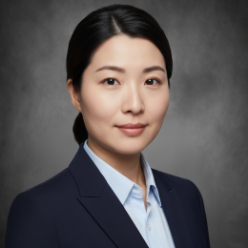
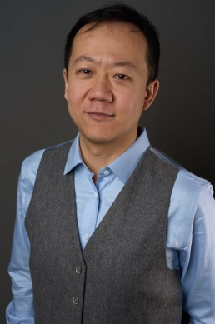
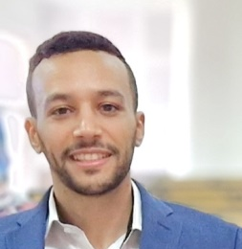
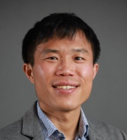
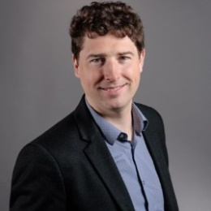
Management team
Ina Wang
CEO
15 years in commercial & trades
Leadership in cold chain logistics.
Proven success in business development, and scaling revenue.
Fund raising.
University of London
Dr. Frederic Cui
CSO
12 years of creating deep-tech companies.
Technology transfer, management of large industrial projects in buildings, minerals, and batteries.
Skilled in building high-performance, cross-functional teams.
Mines ParisTech.
Dr. Tarik Aaboub
CTO
5 years in applied materials research.
Design and scaling of processes.
ENS Paris.
Qin Yu
COO
15 years operational & industrial management
Logistics, installation, supply chain.
Direct coordination of teams of technicians in PV and HVAC,
University Centrale Lyon.
Nicolas Paris
CFO
18 years in financial, operational, and legal affairs.
Trust funds, Family office.
University of Liege
AirTransformer: Less water, less energy, more impact
CONFIDENTIEL © 2024-2028 Savery Tech

Slide 12
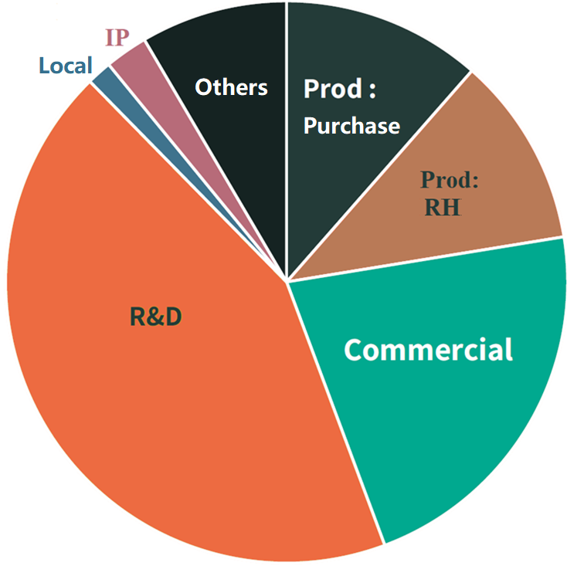
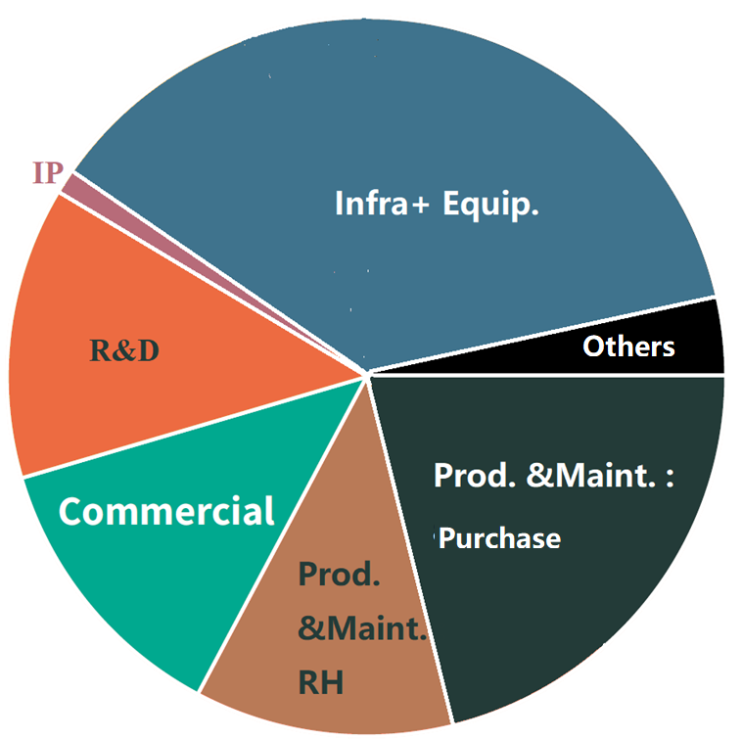
Funding plan
Seed funding:
€1.5M dilutive
€3.5M non-dilutive
Series A funding:
€25M dilutive
€15M non-dilutive
Distribution of expenses with the seed funding from 2025 to 2026.
Evolution of the distribution of expenses in 2027.
AirTransformer: Less water, less energy, more impact
CONFIDENTIEL © 2024-2028 Savery Tech

Slide 13
Expectations
Key indicator | Estimation | Assumptions / Explanatory notes
CapEx (pilot plant) | 25–28 M€ | Total cost including industrial installation, production line, and initial system ramp-up.
Installed annual capacity | 120–180 MW (cold) | Annual cooling capacity delivered (industrial, commercial, and B2B applications).
Annual revenue (Years 2–4) | 33–166 M€/year | Full sale of the produced capacity to high-demand markets with energy efficiency incentives and low carbon emissions.
EBITDA (Years 2–4) | 9–51 M€/year | Achievable EBITDA after industrial optimization, supply chain maturity, and market adoption.
Return on investment (ROI) period | 3–4 years | Facilitated by operational savings, rapid market adoption, and available public incentives.
ROI (Return on Investment) in 5 years | 30–40 % | Cumulative return over five years, accounting for potential growth and profitability improvement.
Levelized Cost of Cooling (LCOC) | ~0,026 €/kWh cooling | Competitive cost for the customer over a 10-year lifespan, thanks to a significant reduction in energy costs.
Customer IRR (Internal Rate of Return) on equipment | France (Paris ~5 years), Germany (~3,5 years), Spain (~2,5 years) | Regional payback considering carbon credits but excluding European subsidies (typically 30% of CapEx).
AirTransformer: Less water, less energy, more impact
CONFIDENTIEL © 2024-2028 Savery Tech

Slide 14
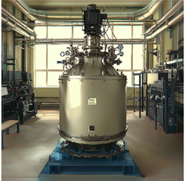
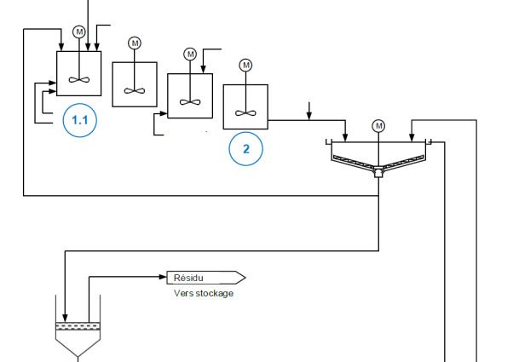
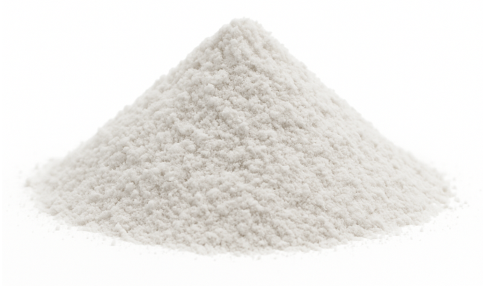
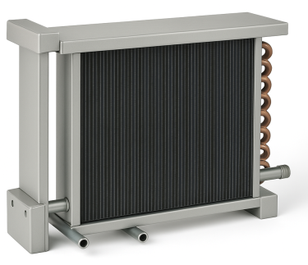
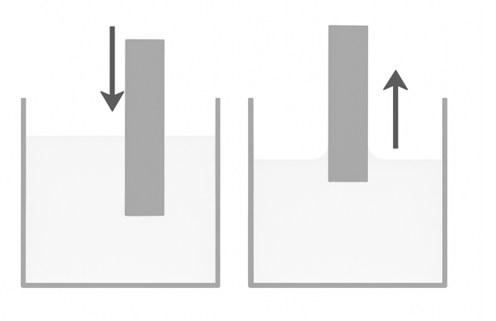
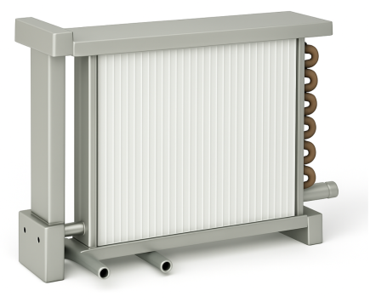








FOAK plant process
Process conception
Sorbents
OEM
Infrastructure
Propriatary protocol /
Know-how
HX microchannel
Green chemistry
Protocol
/ Know-how
Assembly
AirTransformer®
Curing
Coating
OEM
Purchase
AirTransformer: Less water, less energy, more impact
CONFIDENTIEL © 2024-2028 Savery Tech

Slide 15

Site Map, Impact & Jobs ÎDF
Measurable decarbonization, local jobs, clear planning at the ÎDF Fund.
Building: :
3,500–5,000 m², 8–10 m H.L., 3–5 platforms; noise ≤55/45 dB(A) (D/N).
Utilities:
Electric 3.0–4.0 MW (peaks 4.5–5.0), water 15–25 m³/h, effluent 5–10 m³/h (pre-treated), gas 500 kW PCI (option).
ICPE :
Expected D/E (solvents, storage, thermal);
Water process excluding F-Gas, A2L compliant test benches.
Logistics/Employment:
≤60 min from road hubs; process/HVACR/QHSE basin in the Paris region; work-study/active training.
Paris region covenant: first plant and territorial anchoring formally accepted.
Assumptions:0.30 EU/0.05 FR tCO₂/MWh
AirTransformer: Less water, less energy, more impact
CONFIDENTIEL © 2024-2028 Savery Tech
Notes:
Proactivité: Nous contractualisons l’ancrage ÎDF et plaçons l’adresse comme condition préalable, avec un plan 24 semaines et des preuves à chaque jalon.
Risque/mitigation: Pour sécuriser les pilotes ≥300 kW, nous pouvons opérer via cellule d’assemblage transitoire/contract manufacturing jusqu’au démarrage du site définitif.
Méthodo & frontières
Unité : 1 MWc (module de refroidissement livré).
Baseline : groupe froid élec. eau/eau COPₑ ≈ 3,3 ⇒ 0,30 kWe/kWc.
Solution : adsorption MOF + chaleur fatale ; auxiliaires ≈ 0,05 kWe/kWc.
Heures : 3 500 h/an (industriel/commercial).
Facteurs réseau : UE-27 ≈ 0,30 tCO₂/MWh ; France ≈ 0,05 tCO₂/MWh.

Slide 16

Financial forecasts
Growth &
profitability
AirTransformer: Less water, less energy, more impact
CONFIDENTIEL © 2024-2028 Savery Tech

Slide 17
Financial forecasts
Year | Shipments (MW) | Sales | COGS | Gross Margin | Cash Opex | EBITDA | EBITDA %
2026 | 0.55 | 0.6 | 0.5 | 0.1 | 5.0 | −4.9 | −815%
2027 | 5.45 | 6.0 | 4.4 | 1.6 | 6.0 | −4.3 | −72%
2028 | 60 | 66.5 | 42.2 | 24.3 | 9.0 | 15.3 | 23%
2029 | 200 | 222.5 | 131.0 | 91.5 | 20.0 | 71.5 | 32%
2030 | 200 | 225.5 | 122.2 | 103.3 | 22.0 | 81.3 | 36%
Scope = equipment only (adsorption chiller MOF-modules, with integrated automation)
→ Excludes civil engineering works and site integration.
Unités : MW = MWcooling (MWc); prices in nominal EUR.
Nominal capacity: 180 MWc/year starting in 2029; 2026–2028 = commissioning & ramp-up.
ASP = €1.10M / MWc → at 180 MWc, hardware sales = ~€198M.
Service/consumables revenues = €15k / MW-year on average installed base → ~€2.3–5.0M (2029–2030).
Hardware COGS per MW decreases with experience:0.90 → 0.80 → 0.70 → 0.65 → 0.60 M€/MW (2026 → 2030).
  Gains: in-house MOF manufacturing (yield, solvent/energy recovery, activation throughput).
  Better supplier terms (HX, vessels, vacuum packages).
  Design-for-Manufacture (DfM) & throughput gains.
Service COGS ≈ 40% of service revenue (spares, logistics, field labor).
Cash Opex = fixed plant costs + SG&A (headcount, site, warranty/service admin).
→ No D&A, interest, or taxes in EBITDA.
Opex evolution with volume ramp-up: €5 / 6 / 9 / 19 / 21M (2026 → 2030) to support quality, service, compliance.
AirTransformer: Less water, less energy, more impact
CONFIDENTIEL © 2024-2028 Savery Tech
Notes:
Why credible vs. benchmarks
€/MW is consistent with industrial sorption/advanced systems (premium to compression), reflecting MOF bill‑of‑materials and packaging.
Gross margin path (to ~45% at scale) is supported by internal MOF cost curve + supplier quotes for major subsystems.
Specific CapEx for the plant (~€25–28 m for 180 MW/yr) maps to bottleneck assets sized by takt‑time × OEE.
Sensitivity we checked (not shown on main slide)
ASP ±10% shifts 2029 sales by ±€20 m and EBITDA by ~±€12–14 m.
COGS ±€0.05 m/MW moves 2029 EBITDA by ~€9 m.
Opex ±€2 m moves 2029 EBITDA by ±€2 m. Shape of ramp unchanged.
Key risks & mitigations
MOF cost/yield risk → pilot mass‑balance locked; suppliers dual‑qualified; solvent/energy recovery KPIs in line commissioning.
HX/adsorber lead times → framework POs + safety stock on long‑lead items.
Permitting/EHS → ICPE pathway pre‑filed; HAZOP actions tracked with owners/dates.
Demand risk → mix of industrial & commercial offtake LOIs; service/consumables attach built into contracts.

Slide 18

Roadmap
AirTransformer: Less water, less energy, more impact
CONFIDENTIEL © 2024-2028 Savery Tech

Slide 19


Funding plan
Seed funding:
€1.5M dilutive
€3.5M non-dilutive
Series A funding:
€25M dilutive
€15M non-dilutive
Distribution of expenses with the seed funding from 2025 to 2026.
Evolution of the distribution of expenses in 2027.
AirTransformer: Less water, less energy, more impact
CONFIDENTIEL © 2024-2028 Savery Tech

Slide 20
Expectations
Key indicator | Estimation | Assumptions / Explanatory notes
CapEx (pilot plant) | 25–28 M€ | Total cost including industrial installation, production line, and initial system ramp-up.
Installed annual capacity | 120–180 MW (froid) | Annual cooling capacity delivered (industrial, commercial, and B2B applications).
Annual revenue (Years 2–4) | 33–166 M€/year | Full sale of the produced capacity to high-demand markets with energy efficiency incentives and low carbon emissions.
EBITDA (Years 2–4) | 9–51 M€/year | Achievable EBITDA after industrial optimization, supply chain maturity, and market adoption.
Return on investment (ROI) period | 3–4 years | Facilitated by operational savings, rapid market adoption, and available public incentives.
ROI (Return on Investment) in 5 years | 30–40 % | Cumulative return over five years, accounting for potential growth and profitability improvement.
Levelized Cost of Cooling (LCOC) | ~0,026 €/kWh cooling | Competitive cost for the customer over a 10-year lifespan, thanks to a significant reduction in energy costs.
Customer IRR (Internal Rate of Return) on equipment | France (Paris ~5 years), Germany (~3,5 years), Spain (~2,5 years) | Regional payback considering carbon credits but excluding European subsidies (typically 30% of CapEx).
AirTransformer: Less water, less energy, more impact
CONFIDENTIEL © 2024-2028 Savery Tech

Slide 21
Fundraising Breakdown
Source | Equity (Dilutive) | Grant / Loan (Non-Dilutive) | Instrument Details
Indus. | €7.0M | – | Strategic investor in HVAC/DC domain
VCs/FOs | €6.0M | – | Combined private + venture consortium
Île-de-France Reindus. Fund | €3.0M | – | Regional equity investment for industrial scale-up
Bpifrance | €2.0M | €3.5M | Capital infusion supporting industrial innovation
EIC Accelerator | €10.0M | €2.5M | EU-level co-investment via EIC Fund
ADEME+Banque commer. (Grant/Loan) | – | €6.0 M | “France 2030,” Decarbonation Industrie, Numérique program (non-dilutive)
Subtotal | €25.0M | €15.0M | Dilutive from private, grants/loans from Bpifrance, EIC, ADEME
Total | €40M overall |  | equity + non-dilutive
AirTransformer: Less water, less energy, more impact
CONFIDENTIEL © 2024-2028 Savery Tech

Slide 22






Path to deployment
In-house
EIC grant (24 mo)
EIC equity (36 mo)
Series B (48 mo)
Economic competence
TRL-9 · 0.5-1MW ·
demo · certification
Niche leader
100MW/yr capacity
· global reach
Scientific breakthrough
Engineering validation
500kg MOF · Pilot · IP
AirTransformer: Less water, less energy, more impact
Notes:
Tandem MOFs turn warm server heat into cooling and useful heat — with a clear path from design to impact

Slide 23

Summary
Mission: Deploy innovative and economically accessible thermal recovery equipment to decarbonize buildings and industries, thereby contributing to achieving carbon neutrality at the terawatt-hour scale.
Strategy: Develop a technological solution offering ten times the performance of current systems, thereby allowing for a strong differentiation from the competition.
Business model :
Design, manufacturing, and direct marketing of equipments.
Sales model:
B2B
Key success factors:
Full control of the industrial chain.
Proprietary patented technologies with strong differentiation.
In-depth understanding of customer needs.
Agility and capability to co-develop with industrial partners.
2. The proprietary software Savery analyzes network, weather, and sensor data to optimize thermal conversion in real-time.
1. AirTransformer
harnesses waste energy sources.
4. Users and infrastructure managers have full, real-time access to energy data, enabling optimized management.
3. Savery actively supports users in converting excess heat into useful cooling.
AirTransformer: Less water, less energy, more impact
CONFIDENTIEL © 2024-2028 Savery Tech
Notes:
Clear impact: By transforming waste heat into useful energy, we help our clients combine economic performance with environmental commitment.
Ambitious vision: Anticipating tomorrow's energy transition today with accessible, reliable, and efficient disruptive technology.

